Slide 1
Character, Comfort and Low Carbon
Retrofit and the Green Homes Grant
Is it right for you?
Presented by Cara Jenkinson for
Highgate Society Sustainable Living and Muswell Hill Sustainability Group
12th Oct 2020

Slide 2
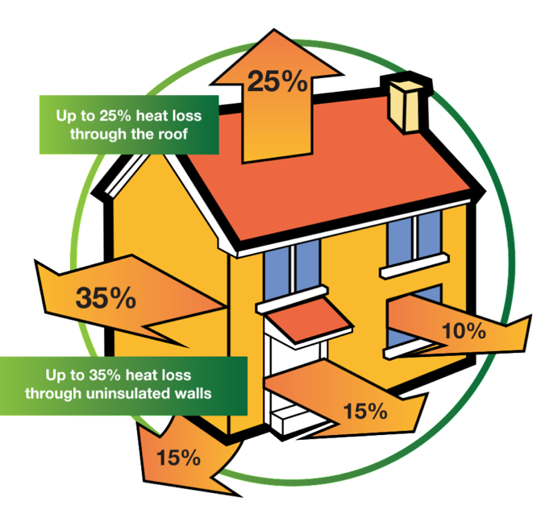
What we’ll cover
What the Green Homes Grant is
Why is the government doing this?
Introduction to retrofit
What measures are covered
Who is eligible.
Who can do the work?
How to apply

Slide 3
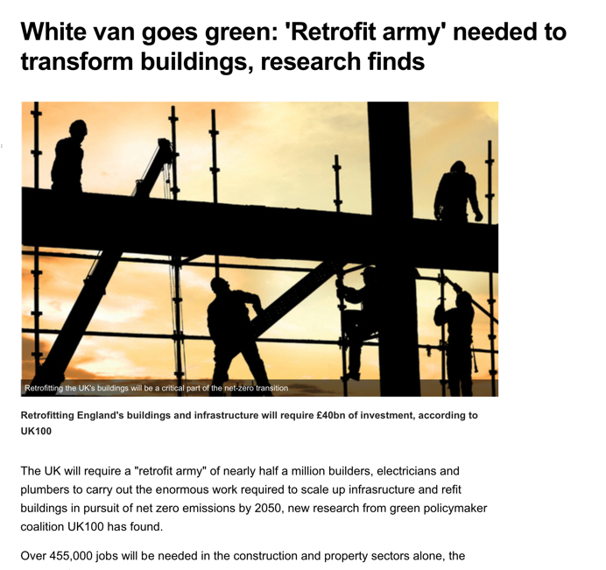
Why is the government doing this?
To hit net zero carbon emissions by 2050
To stimulate green job creation

Slide 4
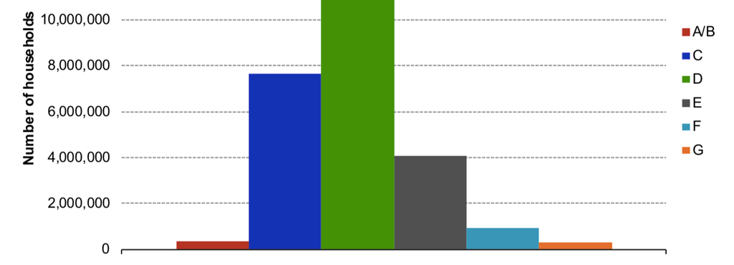
Millions of homes to retrofit
Government target is for all homes to be minimum EPC C by 2035
>1m homes must be retrofitted each year

Slide 5
The Green Homes Grant
£2bn government grant scheme for homeowners and landlords
To install certain insulation and low carbon heat measures – primary measures
Installing these unlocks secondary measures:
Window and doors and heating improvements
Vouchers for 2/3 of cost of eligible work issued, up to a total cost of £5,000 per household
Fully funded up to £10,000 for those on the lowest incomes
All work to be completed by 31st March 2021.
Notes:
Very quick intro – will go into further details later

Slide 6
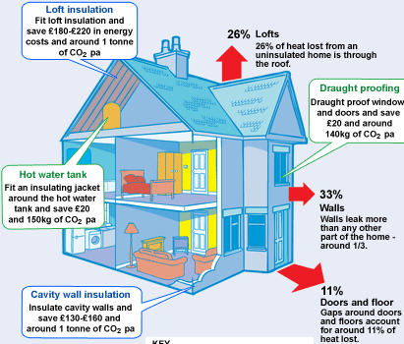
Introduction to retrofit
Energy efficiency measures from low cost to high cost
Renewables such as solar thermal, or air source heat pump
Principles
Fabric first
Whole house
Natural materials
Notes:
Why whole house? Piecemeal improvements may work well but tend to be carried out in isolation, without consideration of the knock-on effects on whole house variables. For example, many homeowners will have had a chimney blocked off, or draughty wooden window frames replaced with modern PVC or PU options. Whilst these improvements will reduce heat loss, they may also have a knock-on effect on ventilation, causing an increased build-up in moisture. Without additional ventilation measures being taken, there’s a danger that humidity will rise to an unacceptable level, potentially increasing the risk of damp and mould. Similarly, without expert input, it’s all too easy to spend on an improvement which doesn’t give optimal results. For example, a homeowner may decide to install solar panels, when actually they would enjoy a greater return on their investment through the installation of solid wall insulation. It’s also the case that some measures may have an adverse effect on others if carried out in the wrong order: wall insulation, for example, may be disrupted if the windows are replaced at a later date. A retrofit plan takes account of these considerations, resulting in a logical, highly effective pathway towards an energy-efficient, well-ventilated home.
Will come back to the requirement for a whole house approach later, in relation to green homes grant.

Slide 7
Cavity wall insulation
Relevant to homes built after 1930, though some homes built between 1919 and 1930 may have cavity walls
Costs between £450 and £750
Potential annual saving £160

Slide 8
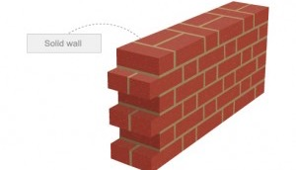
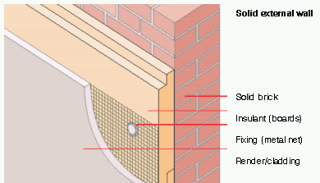
Solid wall insulation (external)
Cost £12,000 - £15,000
Can have brick slips
Likely to involve moving of fixtures e.g pipes
Requires careful attention to detailing to avoid leaks
Savings of £225 - £375 per year

Slide 9
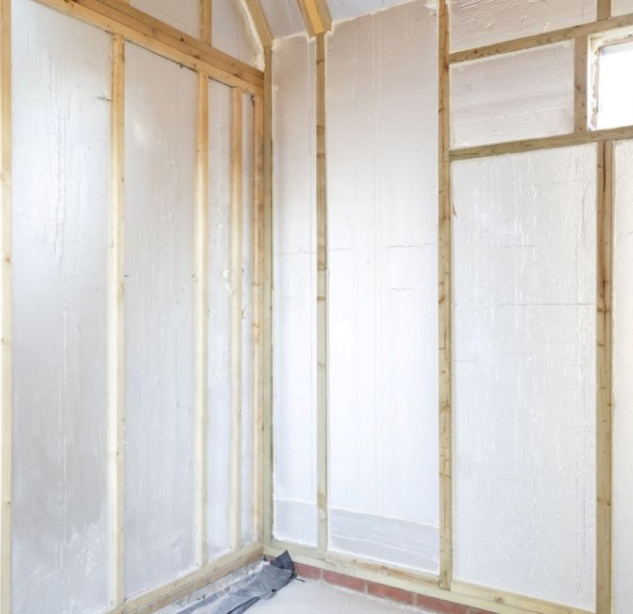
Solid wall insulation (internal)
Cost £7,500
Will reduce the room size a little
Can be done at same time as other work e.g a new kitchen
Will require skirting to be removed first
Savings of £225 - £375 per year

Slide 10
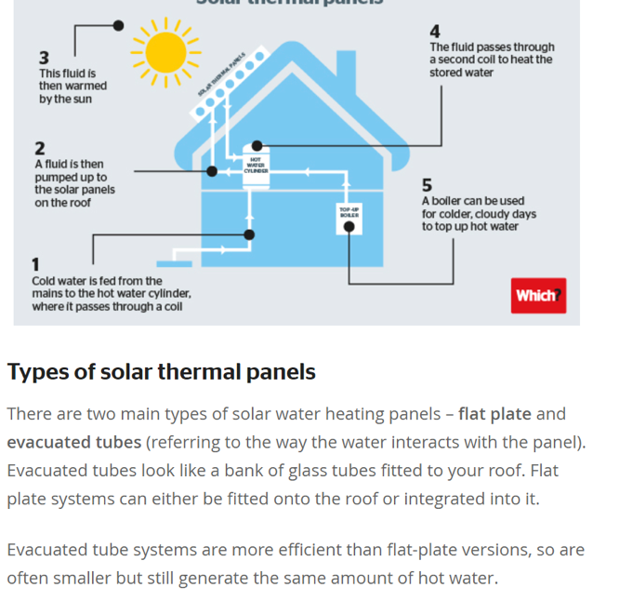
Solar thermal
Cost £4,000 - £5,000
Will heat your hot water but does not do space heating
Best on a south-facing roof
Hot water cylinder needed (doesn’t work with combi-boilers)
Savings of £55 - £95 per year

Slide 11
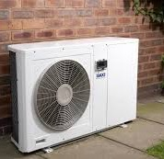
Air source heat pump
Cost £6,000 - £11,000
Works best with underfloor heating and large radiators
Your home should be well insulated and draft proofed.
Need outdoor space – heat pump is the size of a small fridge.
Eligible for Renewable Heat Incentive but amount of green homes grant would be deducted from payments
Unlikely to make energy bill savings if replacing new A-rated boiler
Notes:
You can also use the vouchers to install low carbon heating such as an air source heat pump or solar (thermal) panels for heating hot water, though your home will need to have wall insulation to be eligible. The amount of the grant for a heat pump would be deducted from Renewable Heat Incentive payments, but the reduction in the initial cost could be welcome.
Note according to one ASHP one option is to use GHG to insulate your home, then install a ASHP at your own cost, then claim full RHI payments.

Slide 12
Green Home Grant Measures
Primary measures insulation: solid wall, cavity wall, underfloor, loft, flat roof
Primary measures low carbon heat: Air Source Heat Pump, Ground Source Heat Pump, Solar Thermal, Biomass boiler
Secondary measures insulation: draughtproofing, secondary glazing, double/triple glazing, energy efficient replacement doors
Secondary measures heating: hot water tank insulation, heating controls, hot water thermostats
Notes:
Installing a primary measure unlocks grant tor secondary measures – so you can’t use the grant to put in double glazing alone.

Slide 13
Example
I get floor insulation installed at a cost of £2,000
The government will pay £1,333 of this
I also get a few windows double glazed for £3,000
The government will pay £1,333 of this

Slide 14
Who can install?
Installer of insulation measures must be Trustmark certified
Installer of low carbon heating measures must be MCS certified
Installers must follow certain standards known as PAS (Publicly Available Standards)

Slide 15
Process
Get three
quotes
Apply for
vouchers
Measures installed
Government pays installer
Check eligibility
Apply here: https://greenhomesgrant.campaign.gov.uk

Slide 16
What about Planning?
When you have to ask your planning officer:
Air source heat pumps are permitted development, subject to some restrictions
Solar thermal are permitted development, subject to some restrictions
External wall insulation will require planning permission permission if you are in a conservation area
Planning permission required for window replacement in listed buildings and Conservation areas with an article 4 direction.
Notes:
This is general guidance – you should check with your council’s planning team if in doubt.
Air source heat pumps are permitted development, but must be more than one meter from boundary of property and not on front of house if in conservation area
Solar thermal are permitted development, subject to some restrictions
External wall insulation will require planning permission permission if you are in a conservation area, and may require planning permission if not e.g if you are changing the appearance of the wall
Planning permission unlikely to be granted for front walls in conservation areas, rear and flank walls more likely
Planning permission required for window replacement in listed buildings and Conservation areas with an article 4 direction.

Slide 17
What about Planning?
When you don’t have to ask your planning officer (unless listed building):
Planning permission not required for loft insulation, floor insulation, draughtproofing, secondary glazing, internal wall insulation
Notes:
This is general guidance – you should check with your council’s planning team if in doubt.
The Highgate Society Sustainability Living Group have written to Council leaders in Haringey, Camden and Islington to review planning policies in order that they present less of a barrier to environmental improvements to the housing stock whilst maintaining the heritage values of our housing.
All councils have declared climate emergencies

Slide 18
Whole house plans
Will be required for homes in conservation areas or if you are installing measures with higher technical risk such as solid wall insulation.
You can use some of the Green Homes Grant to pay for this service.
Ecofurb are one organisation providing this service
Notes:
If you live in a conservation area, or you want to install solid wall insulation your Green Homes Grant project will need to follow the PAS: 2035 framework – this means that you’ll need to have a retrofit assessor produce a whole house plan and you will need a retrofit co-ordinator to manage the work

Slide 19
MHSG Open Green Homes events
Monday 19th October, 7.30pm Virtual tour - semi-detached Edwardian villa Followed by Q&A on Zoom with host Stewart McIlroy. Monday 2nd November, 7.30pm Virtual tour - 1980s timber frame detached house Followed by Q&A on Zoom with host Lucy Craig. Webinar: Monday 9th November 7.30pm Green Home Technologies Find out more about insulation, solar panels, heat pumps and smart meters from our expert speakers. Home energy-saving workshop: Monday 16th November, 7.30pm Hot Tips for Warm Homes Find out how to make your home warmer and cut bills and carbon emissions this winter. With Tom Ruxton of HEET, Waltham Forest.

Slide 20
Some observations from us
There’s an urgent need to kickstart home retrofit, and this scheme will help
We recommend a whole house approach
Not a great deal of money for what is needed in many homes
There are unlikely to be enough installers to do the work. This scheme will encourage more installers to participate but…
…the scheme should be renewed after March 2021
Notes:
Comment on skills/installers – that it won’t meet aims for green recovery.

Slide 21
Find out more
Lots more info here: https://highgatesociety.com/place/sustainable-living/retrofit-your-highgate-home

