Slide 1

Air Source Heat Pumps
Edward Sharpley – Sales Manager
-Creating an energy chic home-
#energychic

Slide 2


Reducing CO2 Emissions
The UK Government has committed to reduce greenhouse gas emissions by 34% (from 1990 emission levels) by 2020 to meet legally binding targets.
27% of UK CO2 emissions come from the energy used in our homes

Slide 3
Reducing CO2 Emissions
Today most buildings in the UK burn fossil fuels for space and water heating.
Domestic heating made up 28% of the UK’s energy demand in 2010 and so will play a key role in putting the UK on a cost-effective pathway to meeting its 2050 de-carbonisation targets.

Slide 4
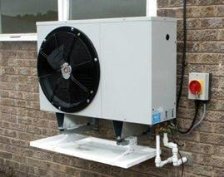
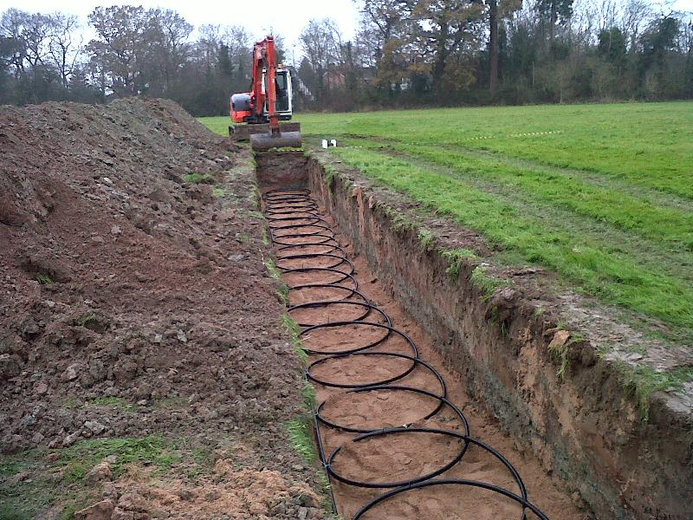

Decarbonizing Energy Generation
By 2030, there may need to be up to 8.6 million building-level low carbon heating systems replacing fossil fuel boilers to meet carbon reduction targets.
By 2050, emissions from heating in homes will need to reduce to almost zero to meet the target of decreasing emissions across the economy by 80%.

Slide 5
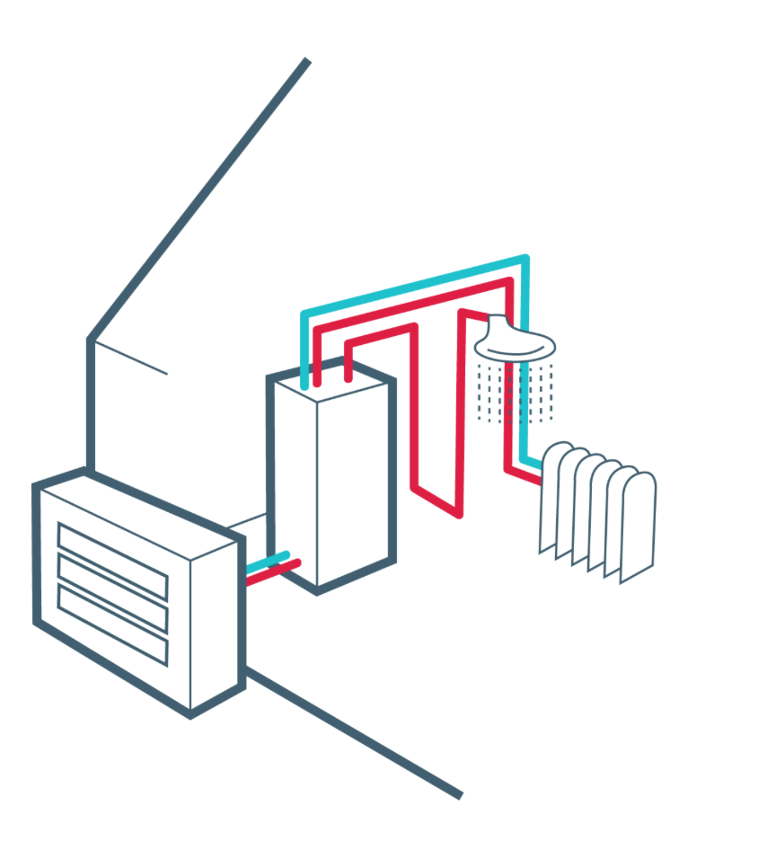
Installation Target
The government has set an ambitious target of 6.8 million heat pump installations by 2030.
As of 2013, slightly over 100,000 heat pumps had been installed

Slide 6
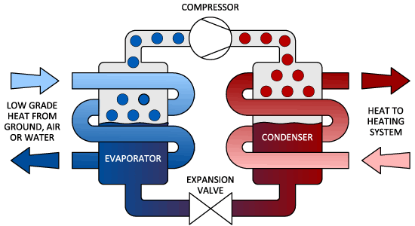
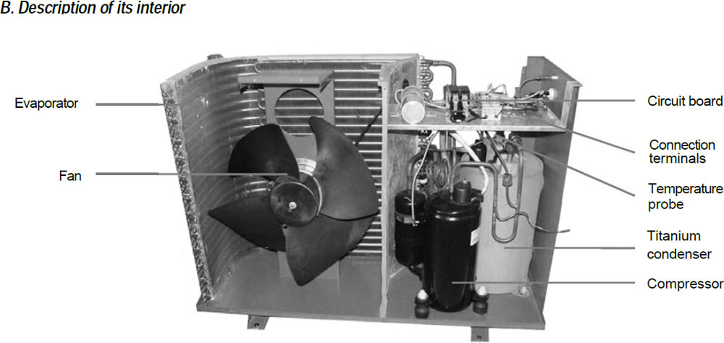
ASHP Basics
Controlled heat output
Lower your fuel bills
Health of house and home
Generates income through the government’s Renewable Heat Incentive (RHI)
Lower carbon emissions
Low maintenance - ‘fit and forget’ technology

Slide 7
Renewable Heat Incentive (RHI)
Compensates home owners for investing in clean technologies, like heat pumps
7 year subsidy scheme, similar to the Feed-In-Tarrif (FIT) for solar PV
Tariffs paid per kWh of renewable heat output
Heat output calculated using Energy Performance Certificate, if a stand alone system

Slide 8
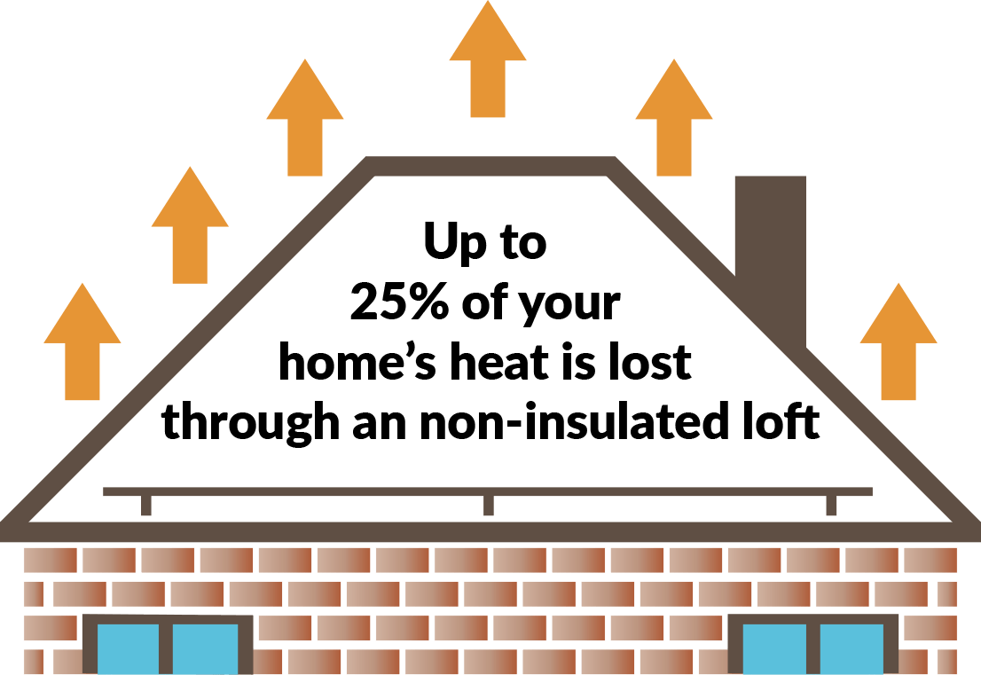
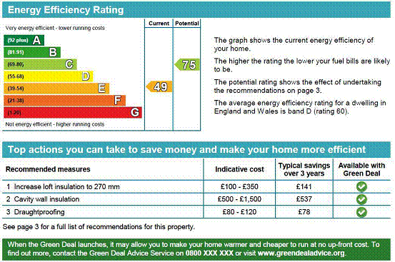

RHI eligibility & EPCs
Loft insulation
Cavity walls
Energy Performance Certificate

Slide 9
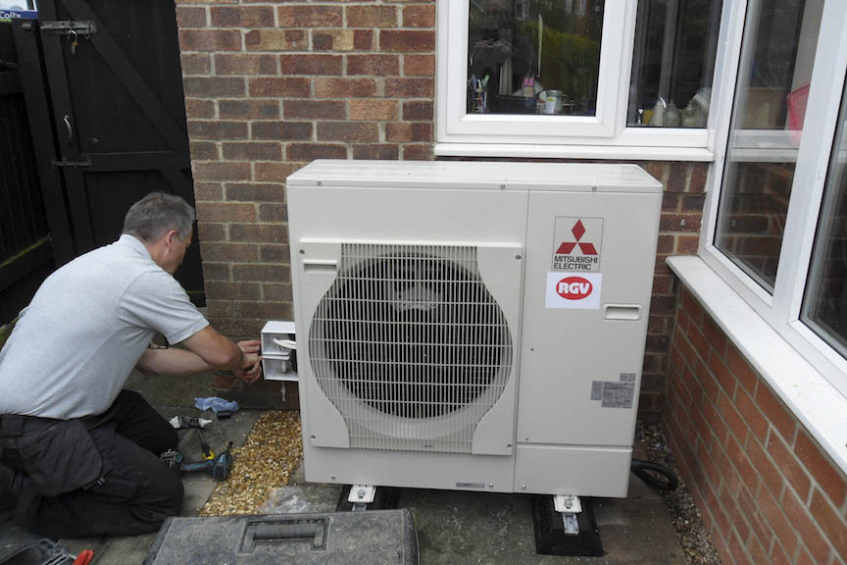
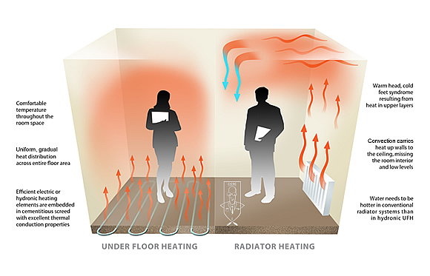
Installation practicalities
Location of external ‘air handling’ unit
Location of hot water cylinder
Plumbing system ‘vented’ or ‘unvented’
Heat emitters
Electricity supply

Slide 10
Franck Energy
Step-by-step approach
Consultation
Property analysis
Specification & price indication
Site survey
Quotation
Installation

Slide 11
02038 088 395

